Slide 1
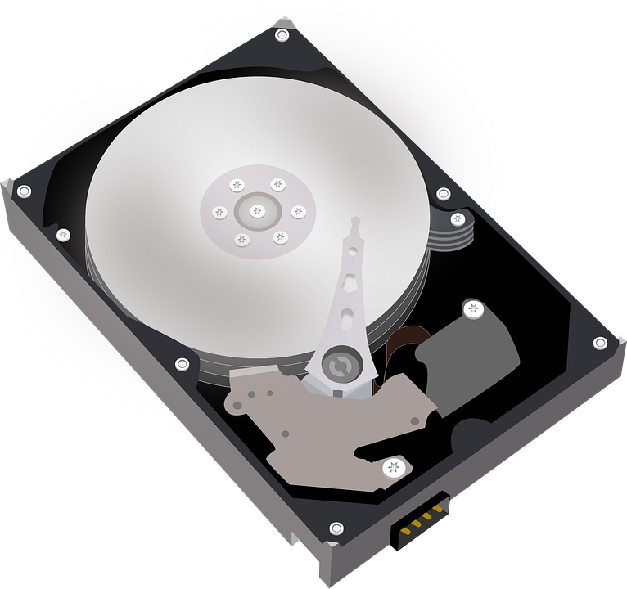
Memory Hierarchy
Presented By:
Bikal Thapa
Suman Timsina
Saugat Acharya

Slide 2
Different Memory in memory hierarchy
1) Registers
2) Cache
3) Primary
4) Secondary
5) Tertiary
Cache
Primary Memory
Secondary Memory
Tertiary Memory
Registers

Slide 3
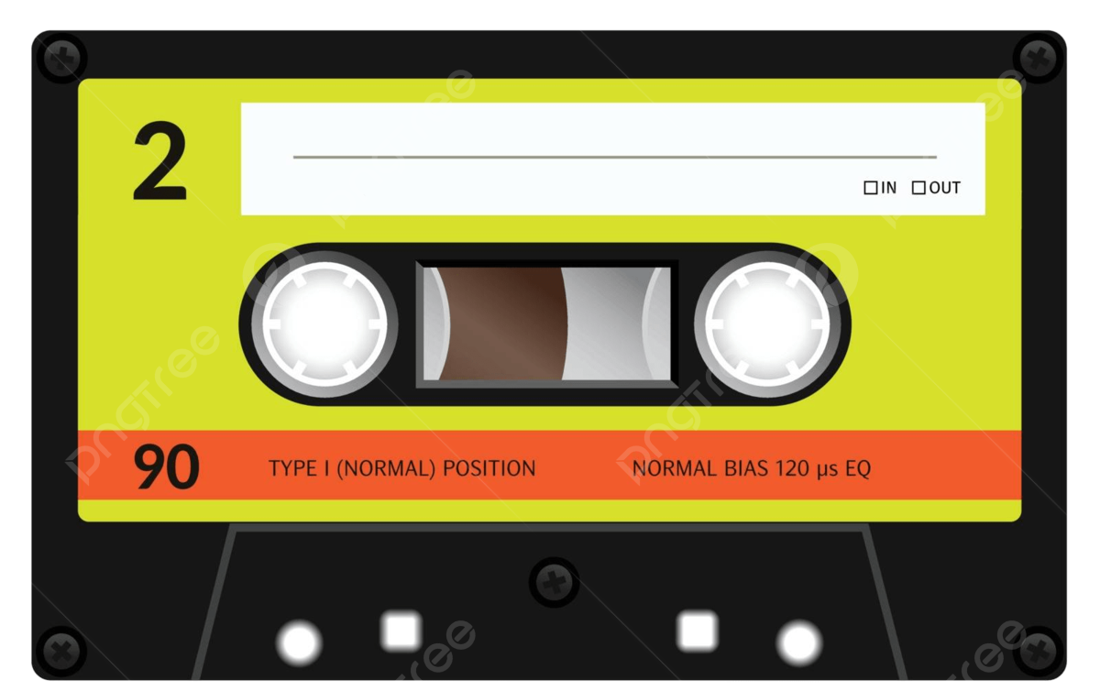
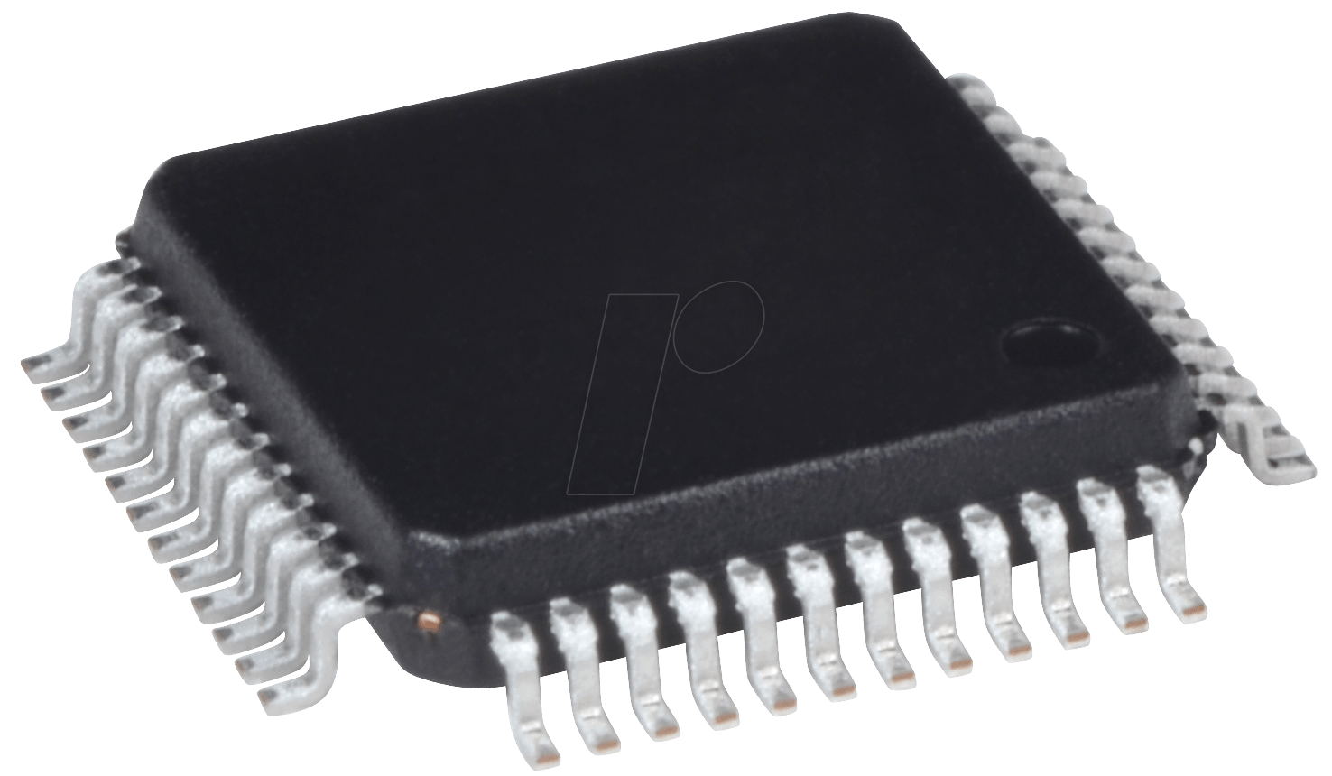

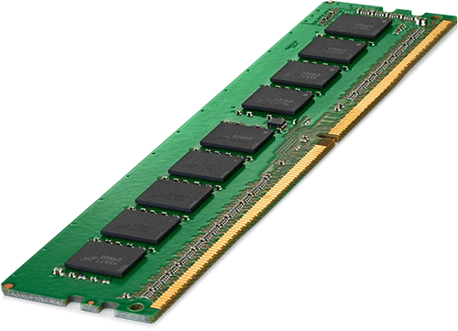
Registers
1
Most Fastest.
2
Implemented using flipflops.
3
Found Inside CPU.
Cache
Primary Memory
Secondary Memory
Tertiary Memory
Registers

Slide 4
Cache Memory
1
Stores frequently used data.
2
Implemented using static ram.
3
Interface between ram and cpu.
Cache
Primary Memory
Secondary Memory
Tertiary Memory
Registers

Slide 5
Primary Memory
1
Implemented using dynamic ram.
2
Communicates with the cpu directly
Cache
Primary Memory
Secondary Memory
Tertiary Memory
Registers
3
It is volatile.

Slide 6
Secondary Memory
1
Permanent storage device.
2
Used as backup storage.
Cache
Primary Memory
Secondary Memory
Tertiary Memory
Registers
3
Cheaper than main memory.

Slide 7
Tertiary Memory
1
Stores large amount of data.
2
Cache
Primary Memory
Secondary Memory
Tertiary Memory
Registers
Slower and cheapest.
3
Rarely used data are stored.

Slide 8

Thank you

